Slide 1
SOCIO
HMRITM
A NEWER WAY TO SOCIAL GROUPS

Slide 2
The idea behind...
Socio is the new age social media networking site for students. Students from all colleges and universities can interact and get to know each other, hence opening endless possibilities for communication & networking.
In socio, students get automatically sorted in groups on the basis of their college. In the feed, you can see posts from all your fellow college students. There is NO need to send and accept requests, just strengthen your network with one click through Socio.

Slide 3
What we have done?
We’ve designed a web platform using HTML, CSS & Javascript for Socio hence providing access to as much students as on the internet out there.
The data, credentials and posts of users will be stored in 3 different databases created using Apache HTTP Servers.
Web pages hold an advantage over apps that you do need any memory to store them on your phone, you need internet access and your network will be strong, in a single click.

Slide 4
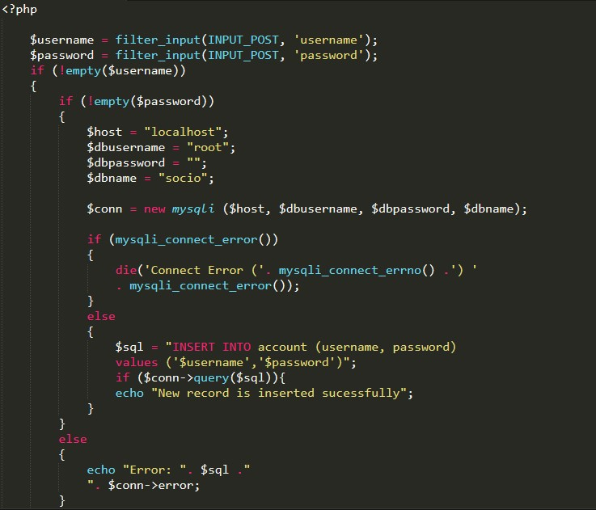
A GLIMPSE OF code for connection to database…

Slide 5
Technologies used
For Socio, we’ve used :
HTML 5
CSS 3
Javascript
SQL
Apache Admin Servers

Slide 6
CREATED by :
Arpit K Jain (007)
Nimish Jain (028)
THANK YOU!

